Slide 1
Attenetion Is All You Need
Mohit Raj Aryal
Amnil Tech internship

Slide 2
Why was it needed?
RNNs were slow.
They struggled with long sequences.
Parallel processing was difficult.

Slide 3
What was introduced?
Remove recurrence.
Use only attention.
Enable full parallelism.

Slide 4
Transformer Architecture
Encoder on the left.
Decoder on the right.
Both use attention blocks.
Both use feed-forward layers.
Both use residual + layer norm.

Slide 5
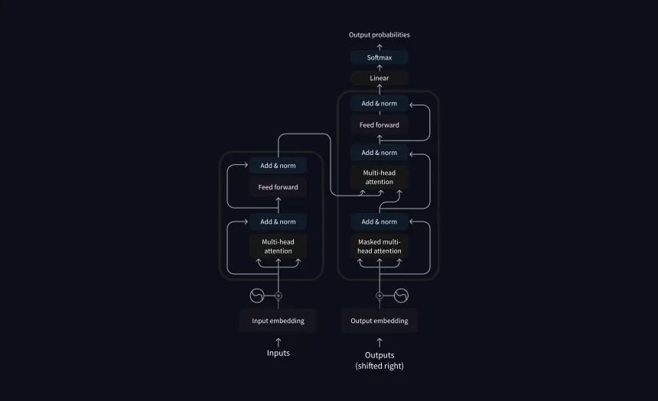
Proposed Architecture

Slide 6
Attention
Core operation of the model.
Measures how tokens relate.
Helps focus on important words.

Slide 7
Scaled Dot-Product Attention
Query × Key gives scores.
Scores are scaled.
Softmax gives weights.
Weights × Value gives output.

Slide 8
Multi-Head Attention
Many heads work in parallel.
Each head learns a pattern.
Captures richer relationships.
Outputs are concatenated.

Slide 9
Positional Encoding
No recurrence means no order.
Positional encoding adds order.
Uses sine and cosine waves.
Helps model understand sequence.

Slide 10
Encoder
Takes input tokens.
Applies self-attention.
Applies feed-forward layers.
Produces context representations.

Slide 11
Decoder
Takes target tokens.
Uses masked self-attention.
Looks at encoder output.
Generates next tokens.

Slide 12
Why Masking?
Prevents cheating.
Model cannot see future words.
Supports autoregressive generation.

Slide 13
Results in the Paper
Outperformed RNNs.
Faster training.
Better translation quality.

Slide 14
Applications
Translation.
Summarization.
Question answering.
Chatbots.
Many more.

